Slide 1
Managing Change
IPP Refreshing Management Skills
Aaron DeBolt and Debra Howell

Slide 2
Objectives
At the end of this session, you will be able to:
Recognize your own and staff’s responses to change
Managing Self
Managing Others
Managing Changes
Learn / be reminded of tools to lead through change
Develop strategies and commit to supporting each other through change

Slide 3
HDCLP/Turning Point Responses to Change
Charger
Victim:
Resists change
Feels angry or depressed
Reverts to old ways of doing things
Critic:
Looks for reasons why change will not be a success
Fails to see any positive outcome from the change
Bystander:
Acts reluctant to get involved
Waits for others to take the lead
Charger:
Leaps before looking; pushes others too hard
Does not listen to others
Navigator:
Looks for ways to reduce negative reactions
Explores reasons for change
Finds ways to be useful in change
Looks for opportunities to improve
Forms positive and supportive relationships with those affected by the change
N
a
v
i
g
a
t
o
r
Critic
Bystander
Victim
Notes:
Have months taped to the end of each row – have people move to the row of their birth month. Show this slide to remind them of the responses to change and ask if anyone had one of those responses when asked to move.

Slide 4
Managing Yourself

Slide 5
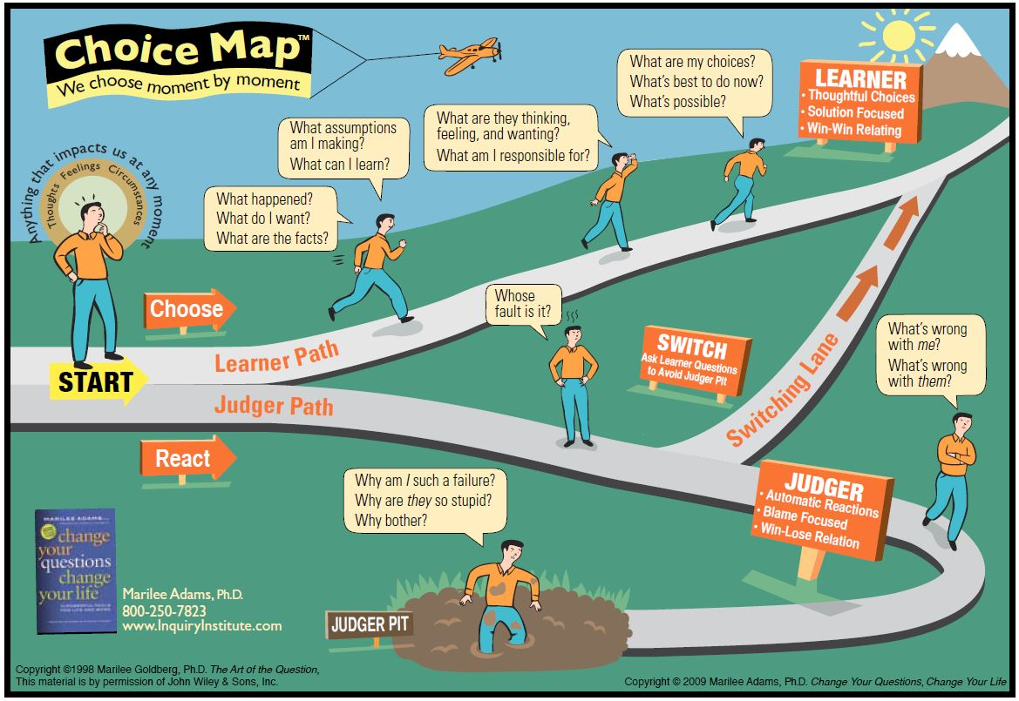
Notes:
In HDCLP and Turning Point, to get unstuck, we use the QBQ – change the WHY to a WHAT OR HOW
HANDOUT – walkthrough the exercise

Slide 6
Questions have more power than answers, both in thinking and communicating.
Notes:
Personal accountability

Slide 7
Managing Others

Slide 8
Wheel of life
Health and Fitness
Work / Career
Fun and Recreation
Spiritual and Ethical
Finances
Social and Cultural
Personal Growth

Slide 9
Example wheel
Health and
Fitness
Work/
Career
Fun and Recreation
Family and Home
0
Spiritual Ethical
Finances
Personal Growth
Social and Cultural

Slide 10
So what?
We each bring our whole self to work
How bumpy of a ride would it be if it were a real wheel?
You don’t know how out of balance someone is
The one minor change that happens at work (turkey vs ham sandwich), could be the thing that throws me over edge.
Notes:
What happens when you get a flat tire?

Slide 11
Helping others
DENIAL Manage yourself Communicate vision Communicate rationale Focus on short-term wins | COMMITMENT Link institution success to individual commitment Recognize individual and group progress Celebrate success
RESISTANCE Opportunities to talk Listen “Allow” negative feelings Model the behavior you want Consider organizational roadblocks | EXPLORATION Provide direction and specific assignments Coach new skills Help others own their situation Incorporate new behaviors into goals
Notes:
Kotter: Leading Change
Talk about mission and vision of IPP

Slide 12
Managing changes
Structural, cost cutting, process, cultural
Notes:
Ask question: what’s changing at the university and within IPP?
Lots of leadership changes; including waiting for a new president
Budget still a factor
IT always changing – new systems

Slide 13
Navigating change is no longer a transition skill; it has become a LIFE SKILL
Our university and the world is at a time of unprecedented change and TRANSFORMATION

Slide 14
Change management v s. transformational leadership
Transformational efforts can be successful for a while, but often fail after short-term results become erratic
All highly successful transformative efforts combine effective leadership and effective management and short-term and long-term results are achieved
Transformation efforts go nowhere
Short-term results are possible, especially through cost-cutting; but real transformation has trouble getting started and major, long-term change is rarely achieved.
Leadership
Management
Notes:
Kotter: Leading Change

Slide 15
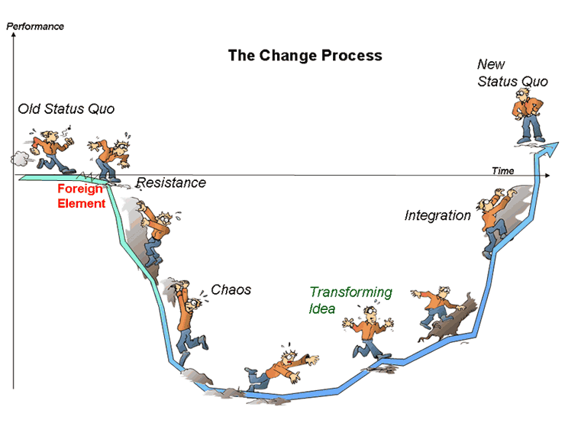

Slide 16
Common myths in times of transformation
Myth 1 – This will go away
Myth 2 – It will help if I get upset
Myth 3 – This is a bad thing for my career
Myth 4 – I can just keep on doing my job like I have been
Myth 5 – Senior management knows a lot more than they are telling us
Myth 6 – Management doesn’t care about us
Myth 7 – I’m not in a position to make a difference
Myth 8 – Management is responsible to make changes
Myth 9 – The changes aren’t really necessary
Myth 10 – University/IPP transformation means: layoffs, centralization, transferring resources

Slide 17
Setting each other up for success
Small group work:
One group works on “mythbusting techniques and communication”
One group works on “strategies to deal with victim, critic, bystander, and charger modes”
One group works on “how do we maximize the involvement of those who are navigators?”
One group works on “how to deal with resistance”
One group works on “what we need to pay attention to with respect to leading staff through change/transformation”

Slide 18
Remember that we are a values-based organization
Truth
Respect
Excellence
Teamwork
Integrity
and our values provide us with a foundation for leading change.
Notes:
BE AN EFFECTIVE CHANGE AGENT – Recognize your staff’s responses to change and then navigate your team through change successfully.
Your attitude will help dictate how staff members navigate through the change.
Be a conduit for information.
If at first you don’t succeed, try again and be persistent.
Practice values based leadership.

Slide 19
Leading Change
QUESTIONS?

